Slide 1

Group 17 presents:
THE BETTER DINO GAME
Bertrand Christopher / SWE2209270
Pisco Fane / SWE2209272
Joshua Evan Wilson / SWE2209276
Chen Jiawei / CME2109130

Slide 2
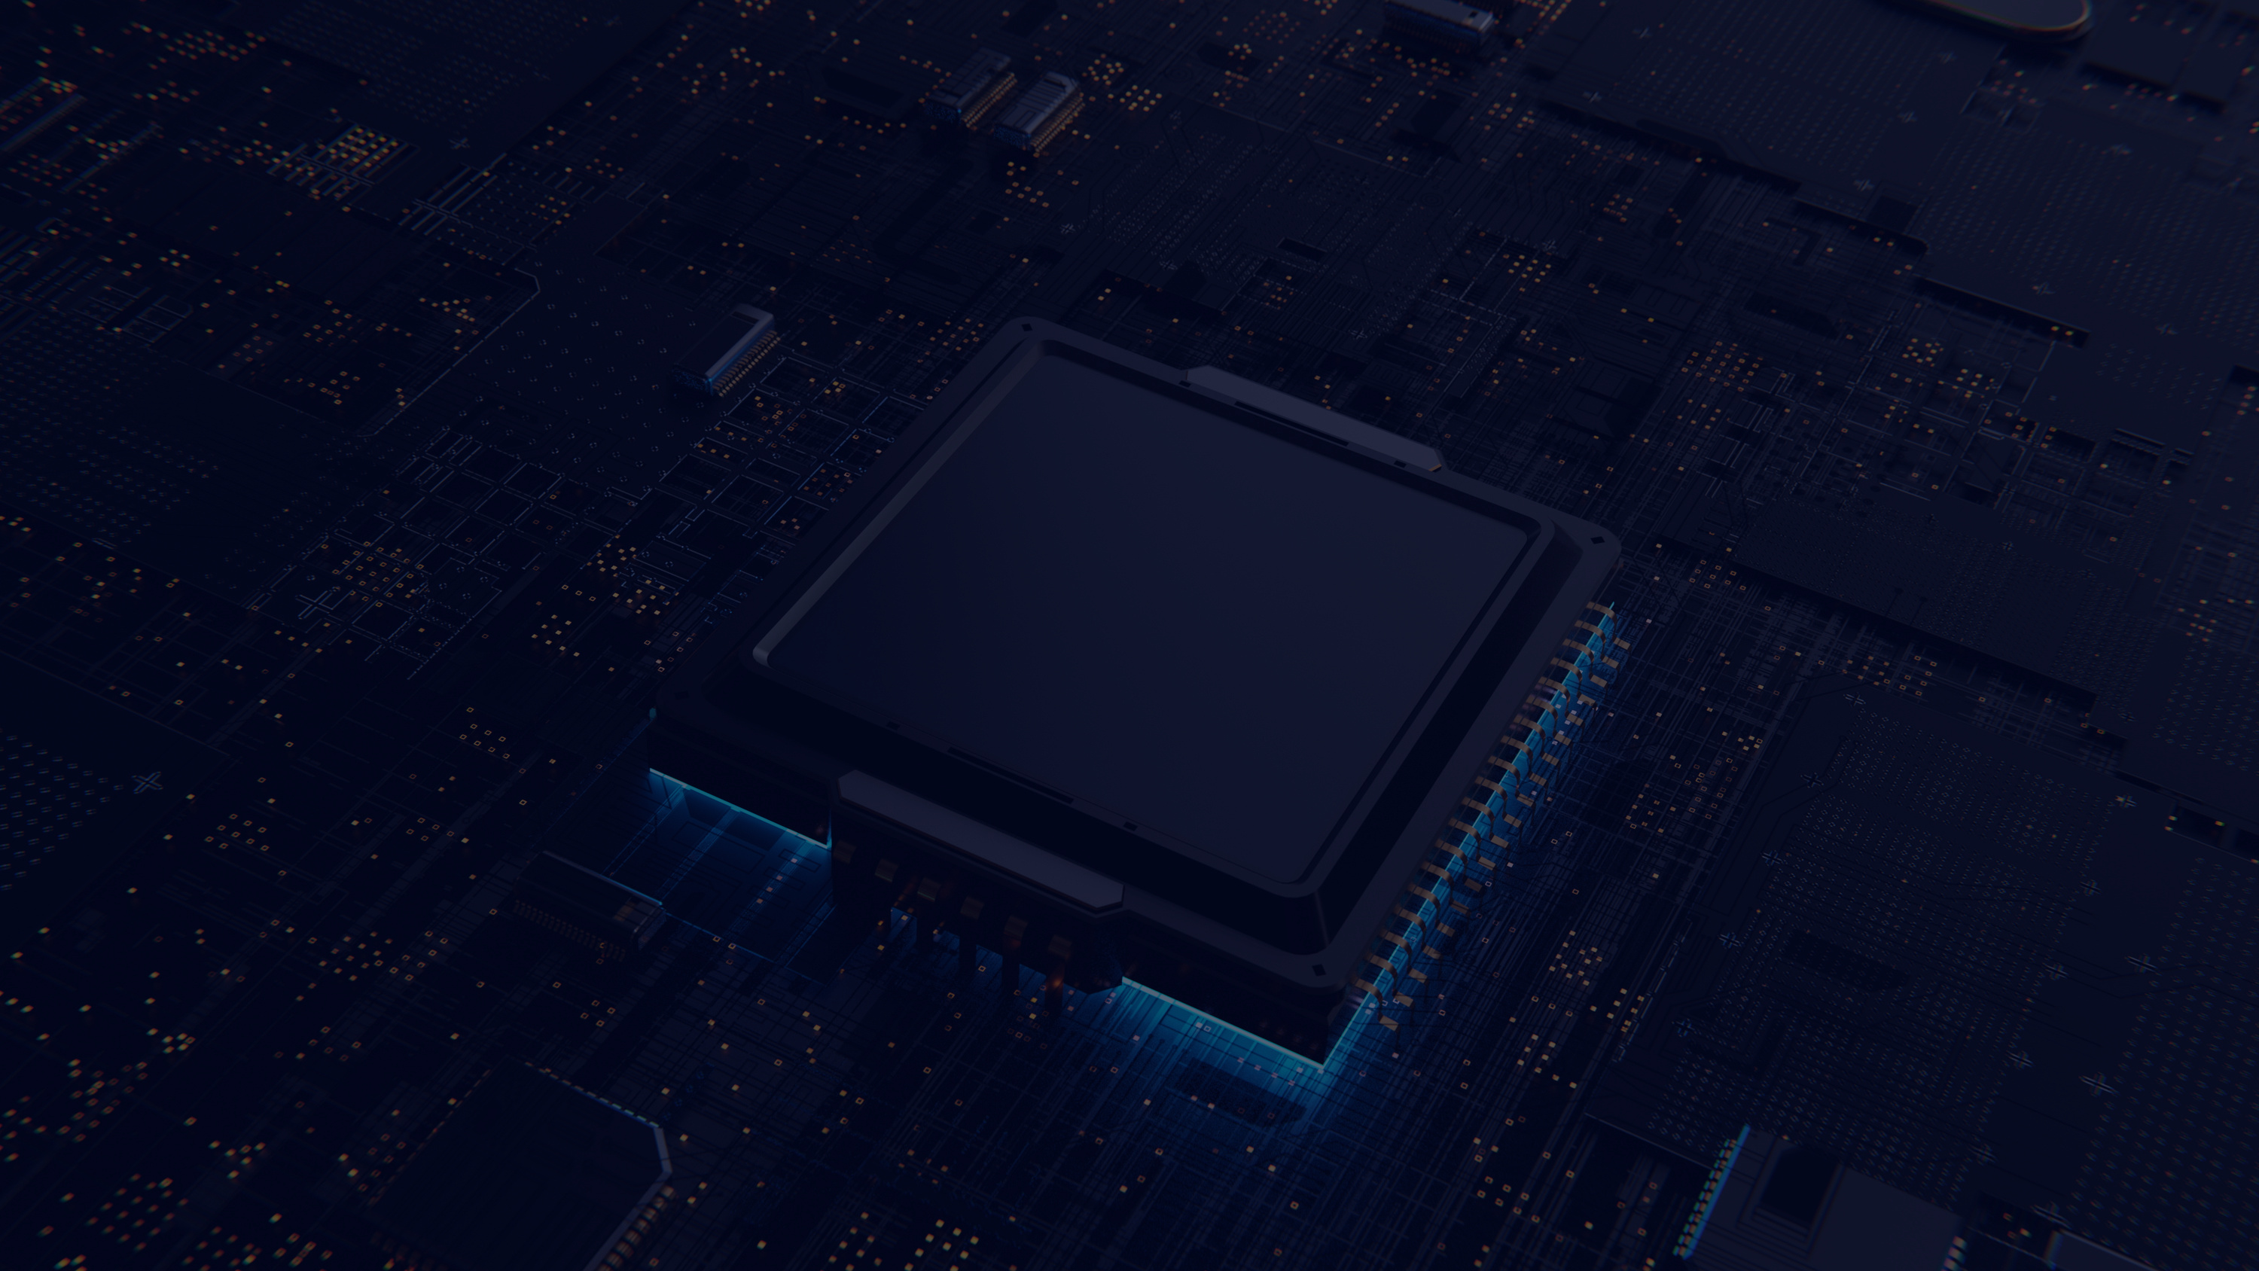
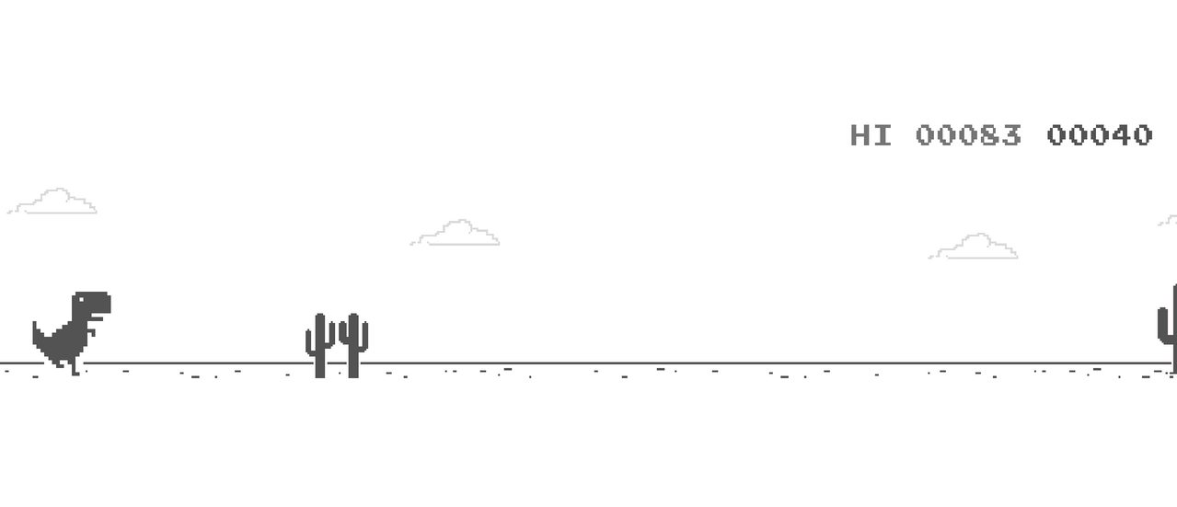
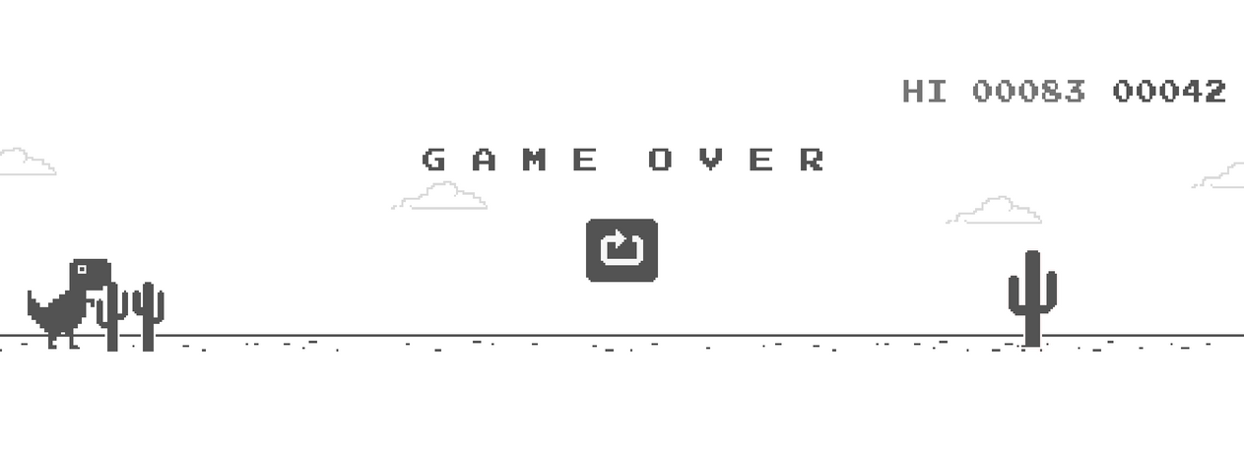
Project Overview
Our Presentation is inspired by the Offline Chrome Dinosaur Game. Using pygame, we are able to create a similar game with some added twist to make the game more fun and interesting

Slide 3

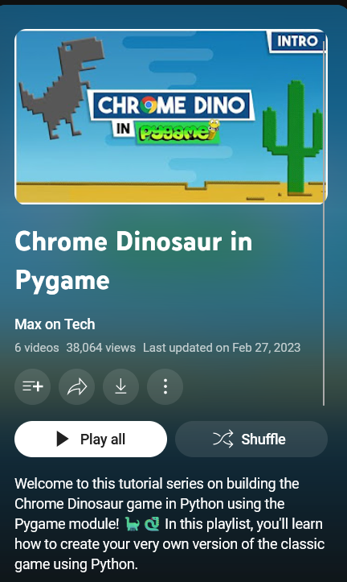

References
https://www.youtube.com/playlist?list=PL30AETbxgR-fAbwiuU1vDl3owNUPUuVrz
Tools Used:
GitHub
GIMP

Slide 4
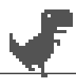
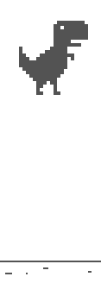
Input
NOTE: in this version of the game players can perform actions with no cooldown.
On default the dino runs standing tall on the ground.
Press `W` or `Up` key to jump (hold jump to reach its maximum; release `W` to go down faster)

Slide 5
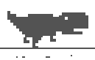
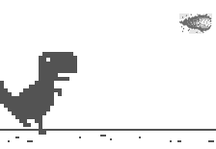
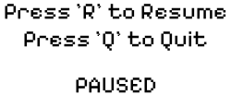
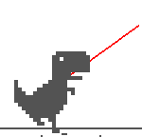
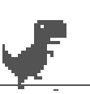

Input
Press `S` or `Down` key to crouch.
Press `Left click` to shoot projectile one time towards where your mouse clicked in the area.
Projectile moves based from the dino's position and to the position where your mouse clicked in a straight line.
Press `Esc` to pause the game.
Press `R` to resume the game instance; There will be a 3 second countdown after the `R` key is pressed.
Press `Q` to quit the game instance and go to menu.
Press `A` key to toggle aim helper which is a red line that is shown from the dino to your mouse cursor.

Slide 6




Implementation

Slide 7


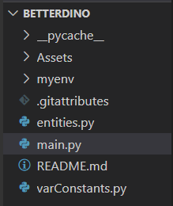

File Structure

Slide 8


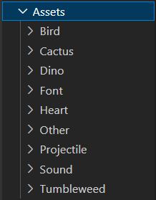
Assets

Slide 9


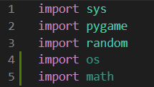

Main Library
sys: Handle system calls such as sys.exit() to terminate the program.
pygame: Handle displays, key inputs, outputs, loading images, etc.
random: Returns randomness output for obstacles.
os: Find the path to the assets used in the game.
math: Import functions related to mathematical problems.

Slide 10


entity.py:
Dinosaur

Slide 11

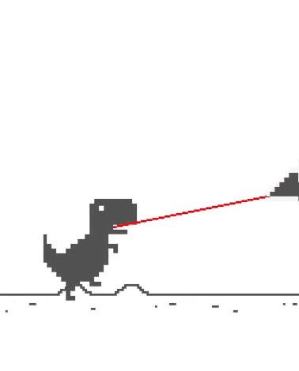
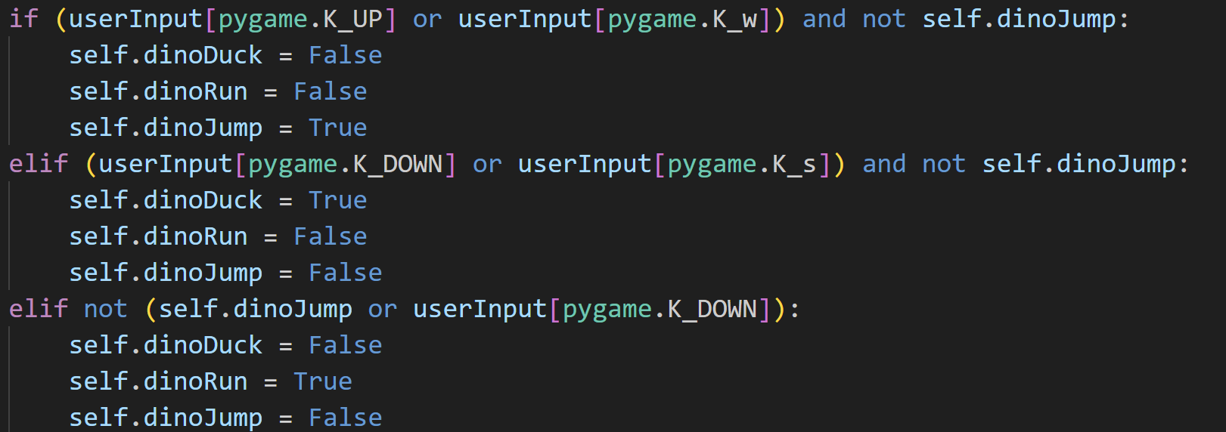
Dinosaur
3 main states:
Running (default)
Jumping
Ducking

Slide 12
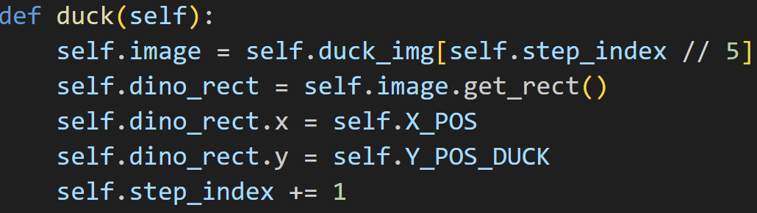
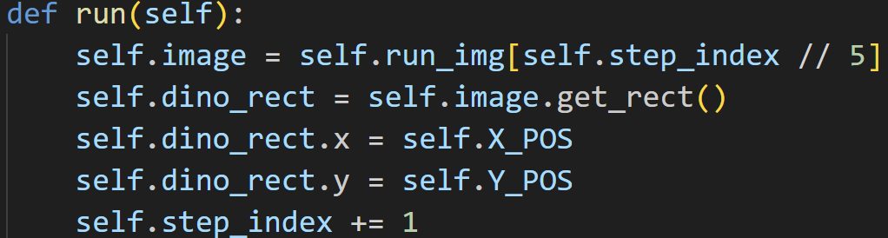
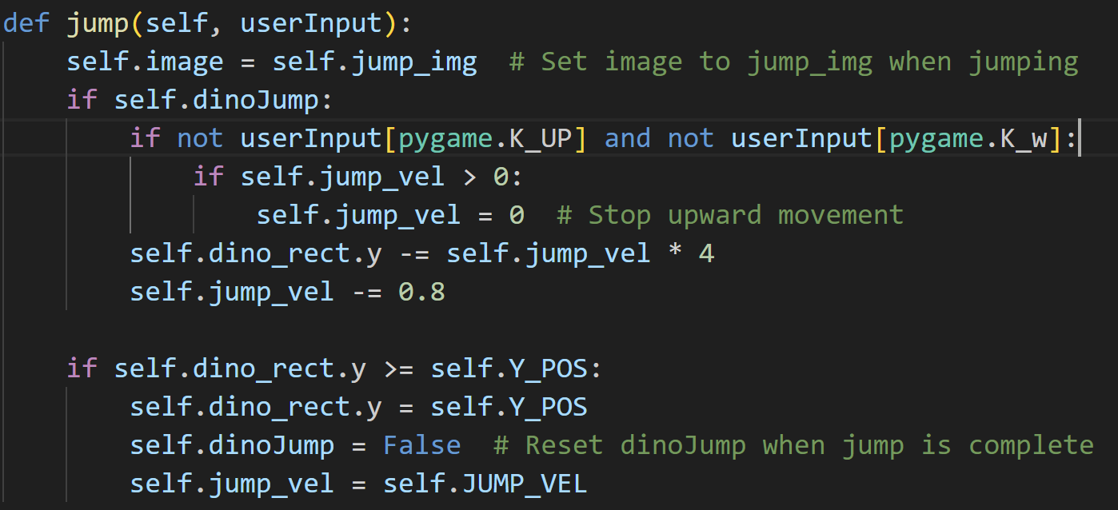
Continued.

Slide 13
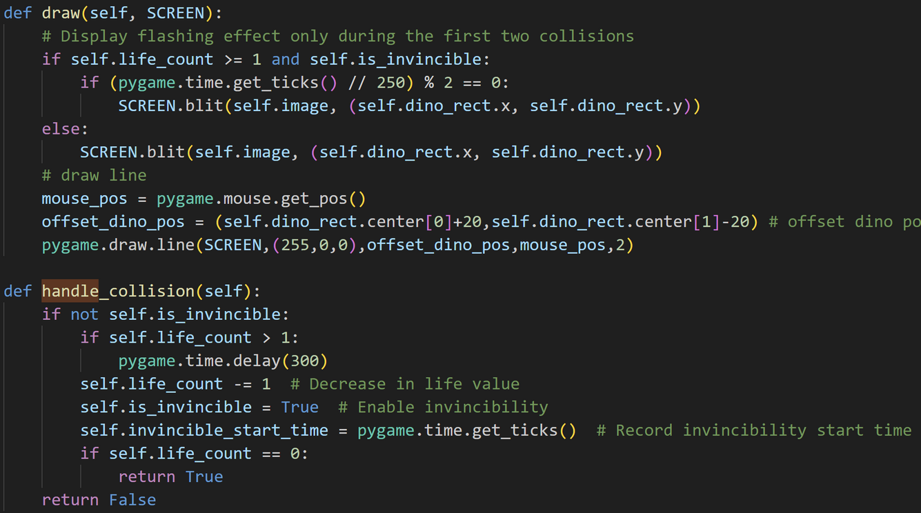




Draw the Dino:
Collision:

Slide 14
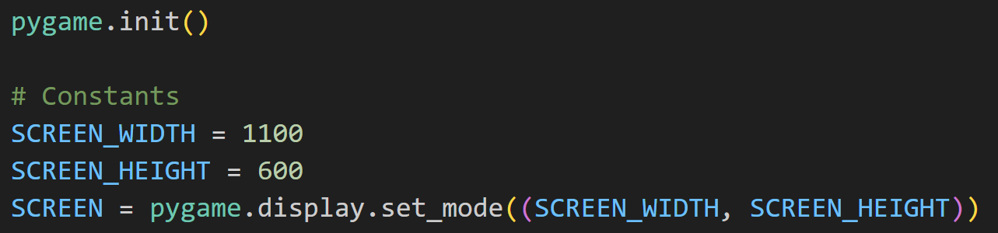
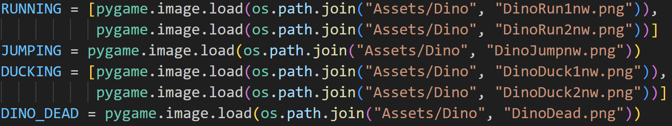
Screen:
Dinosaur:

Slide 15
Background & Obstacles

Slide 16
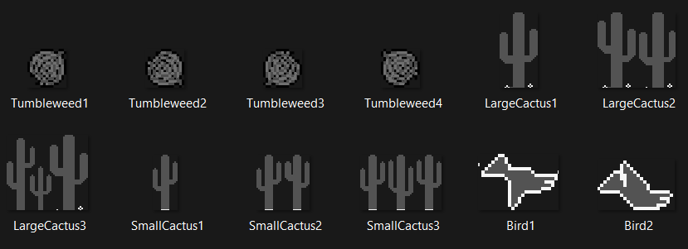
Obstacles:
Whenever Player/Dino collide with any of these obstacles, the Player/Dino will lose health

Slide 17
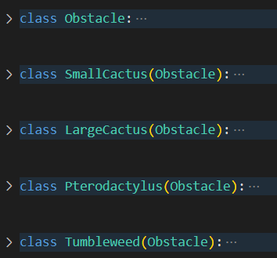


Obstacles:
Parent Class:
Draw Objects, Initialize Objects, Remove Objects
Child Class:
Set size (width, height)

Slide 18
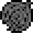
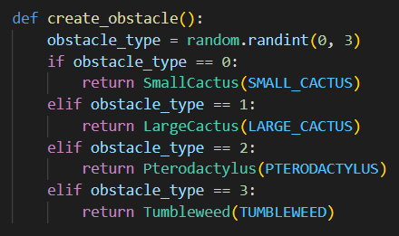
Randomizer

Slide 19



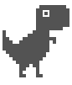
Background, Hearts, Fonts:
Starts at 3 health point (default)
Clouds and Desert is infinite
Obstacles will be spawned infinitely (randomly)

Slide 20
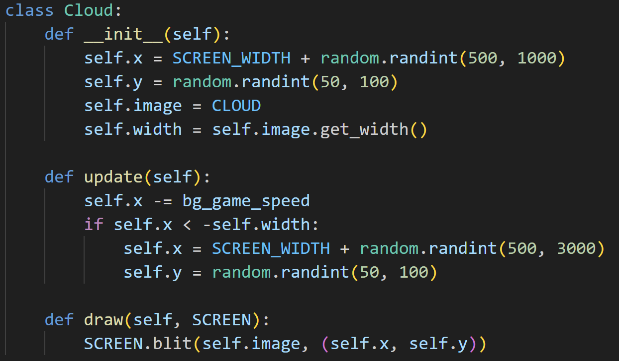
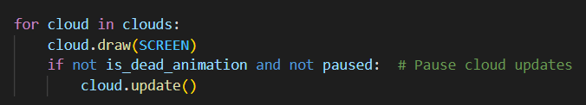
Cloud
<serves for decoration purposes>
<generated in main>

Slide 21

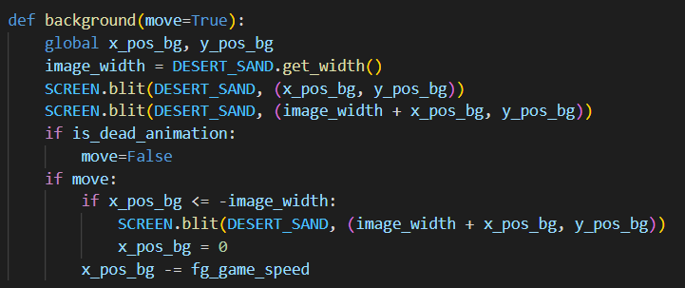


Desert Background
<when player dies desert stop generating>
Used to adjust to game speed

Slide 22
Projectiles

Slide 23
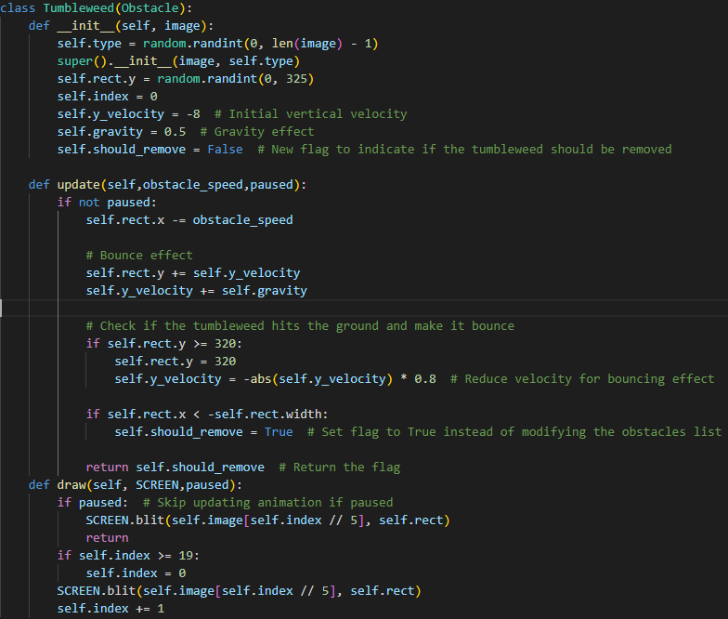
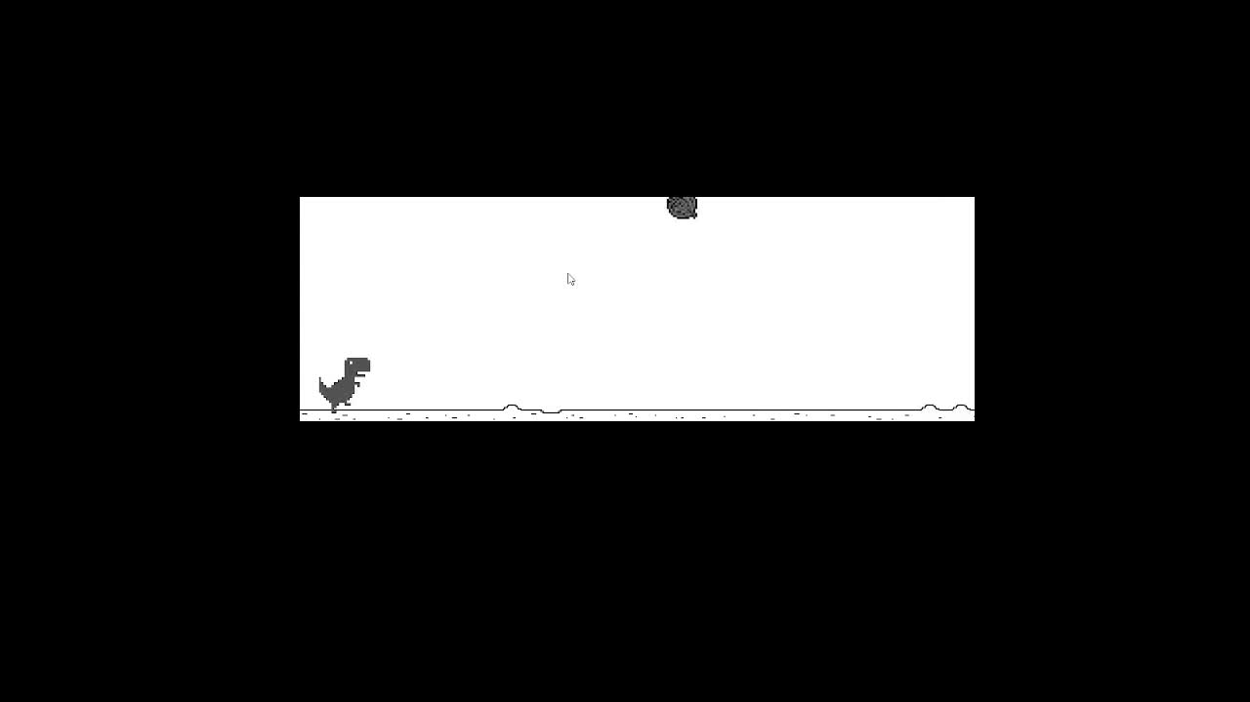
Tumbleweed
entity.py

Slide 24

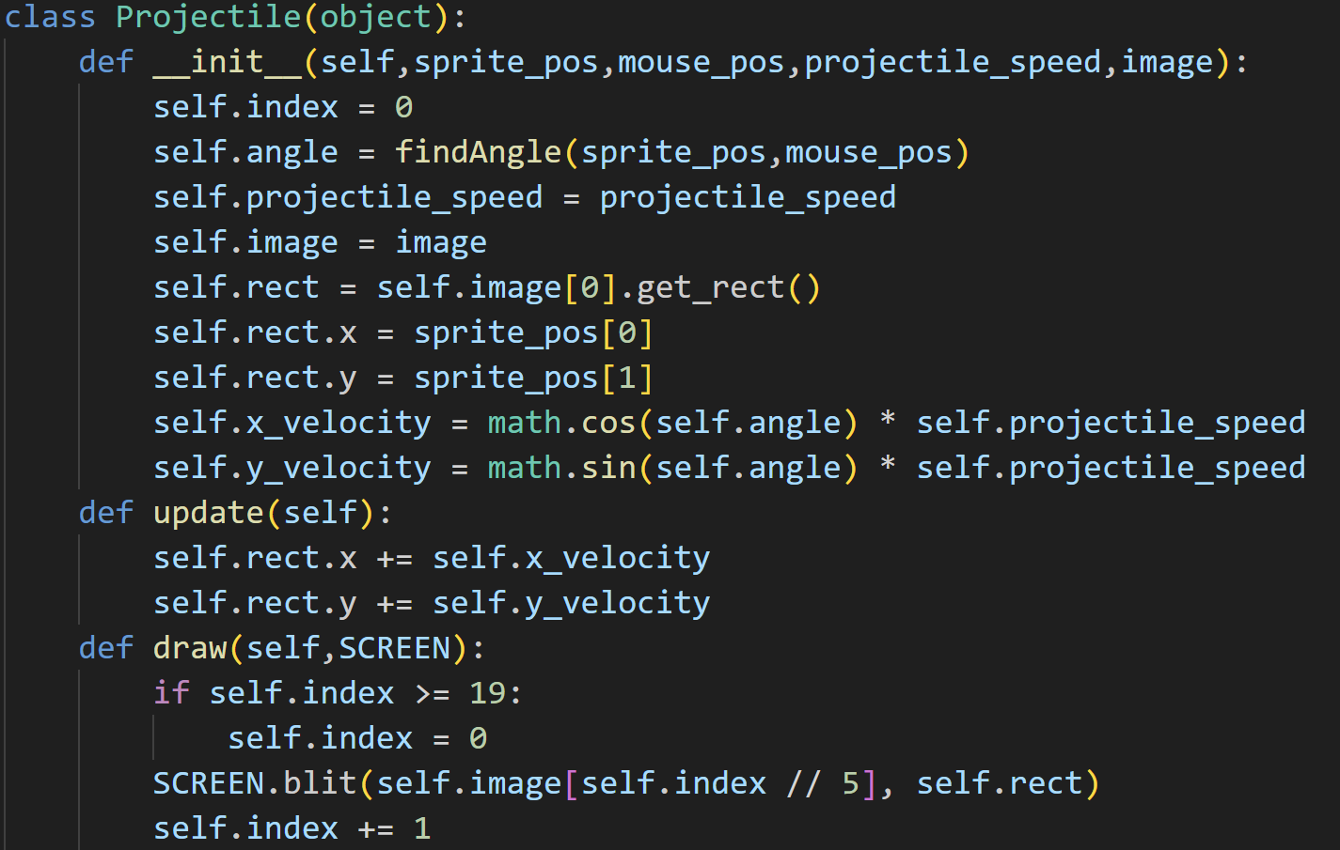
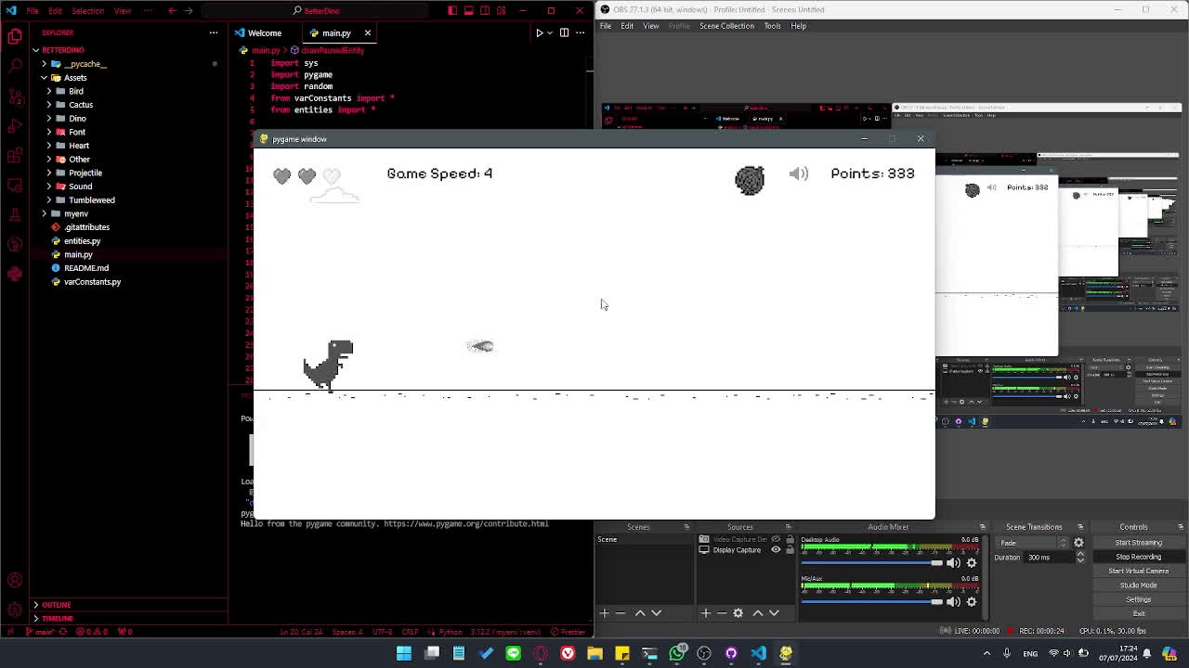
Projectile (fireball)
entities.py

Slide 25
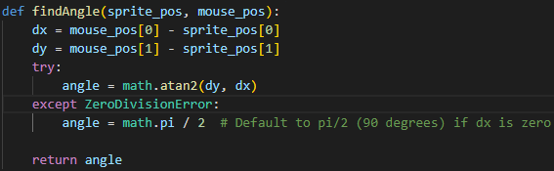
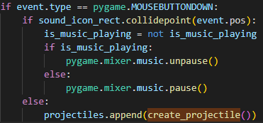
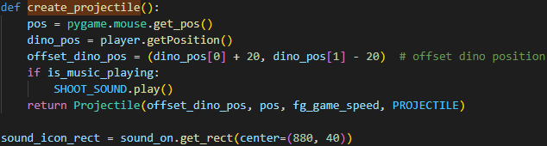
Projectile (fireball)
entities.py
main.py using projectile

Slide 26
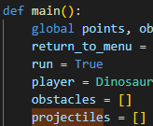
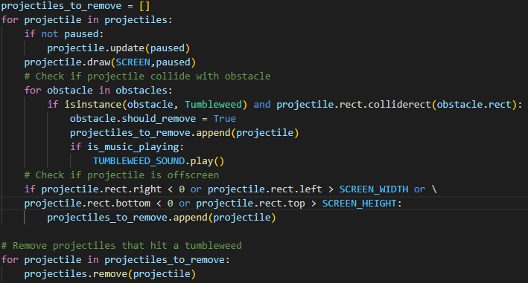
Projectile (fireball)
main.py using projectile

Slide 27
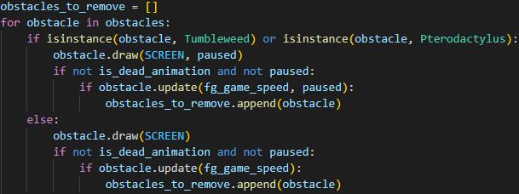
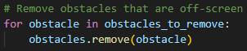
obstacles removed
main.py updating and eliminating projectiles

Slide 28
life mechanism

Slide 29
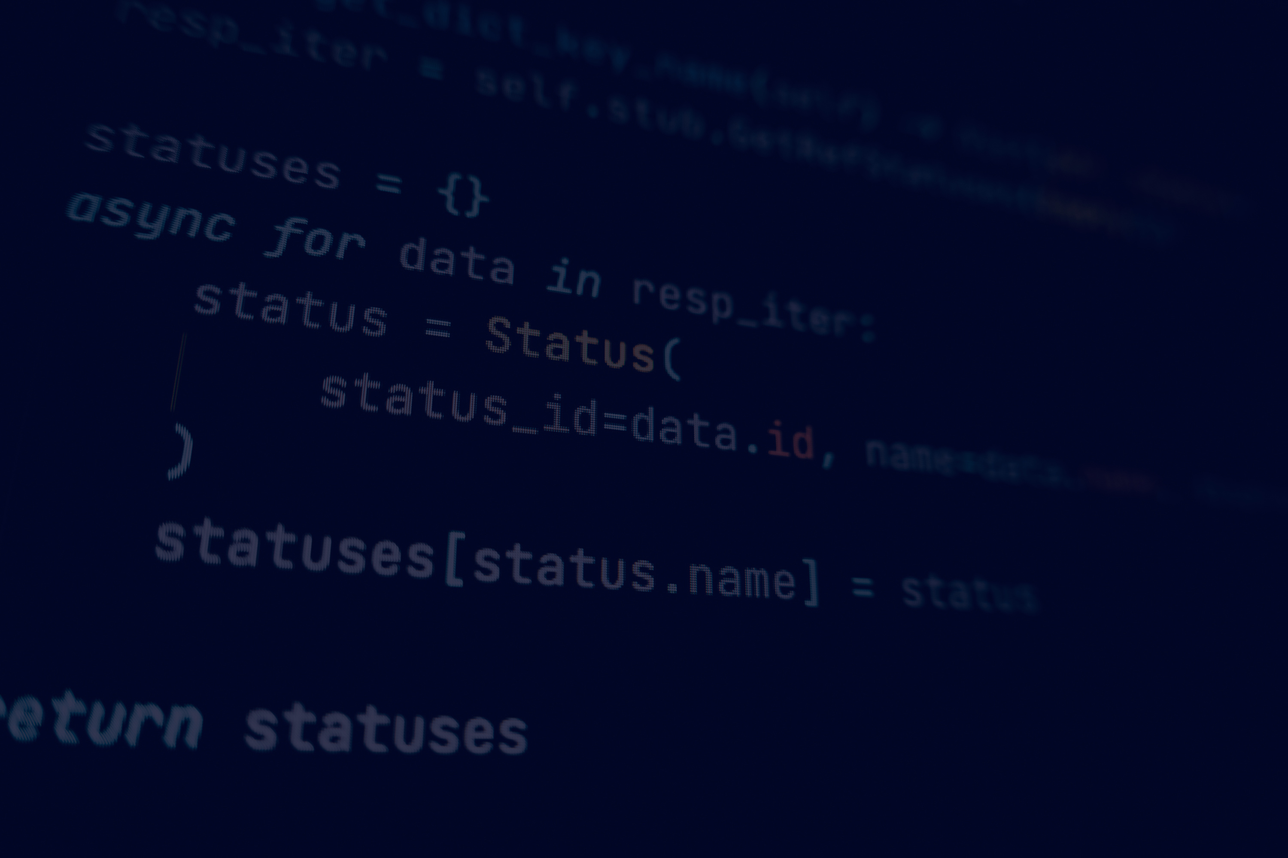
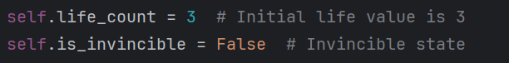
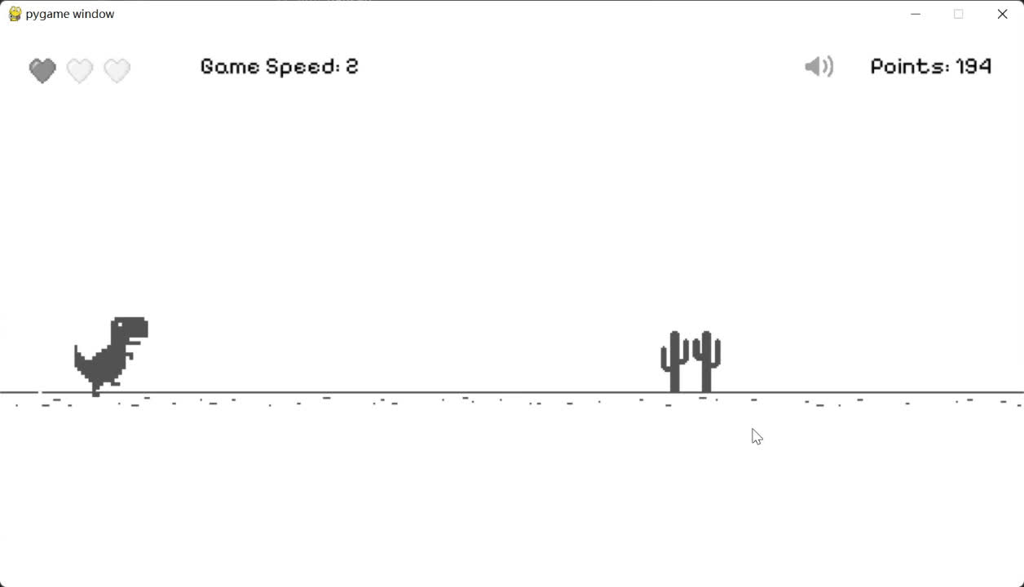
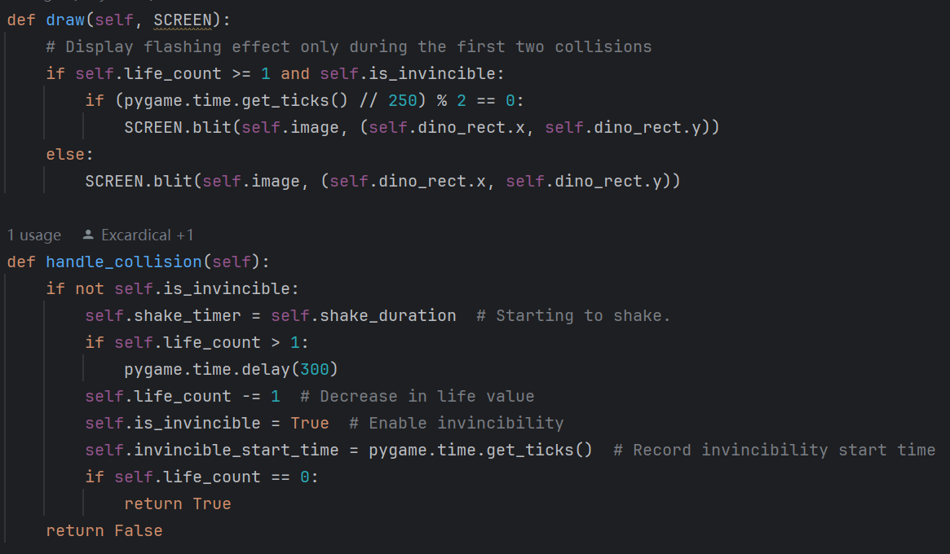
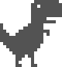

life mechanism
In class Dinasaur:
Collision effect:

Slide 30


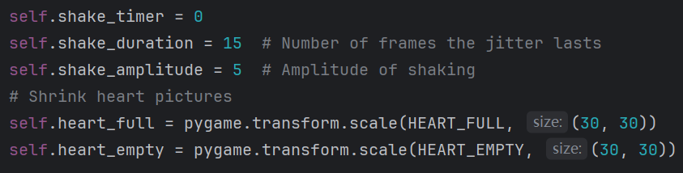
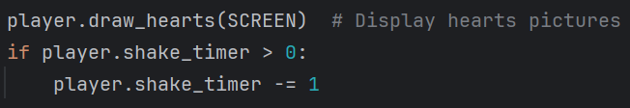
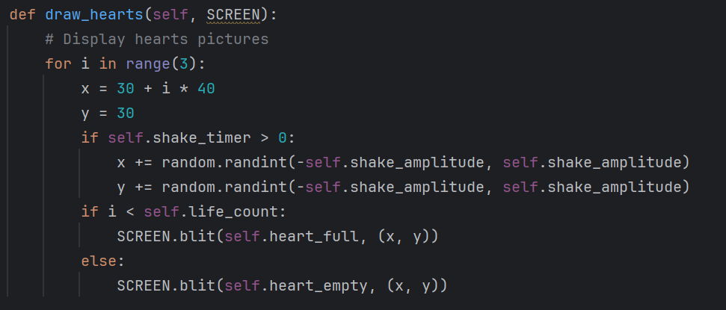
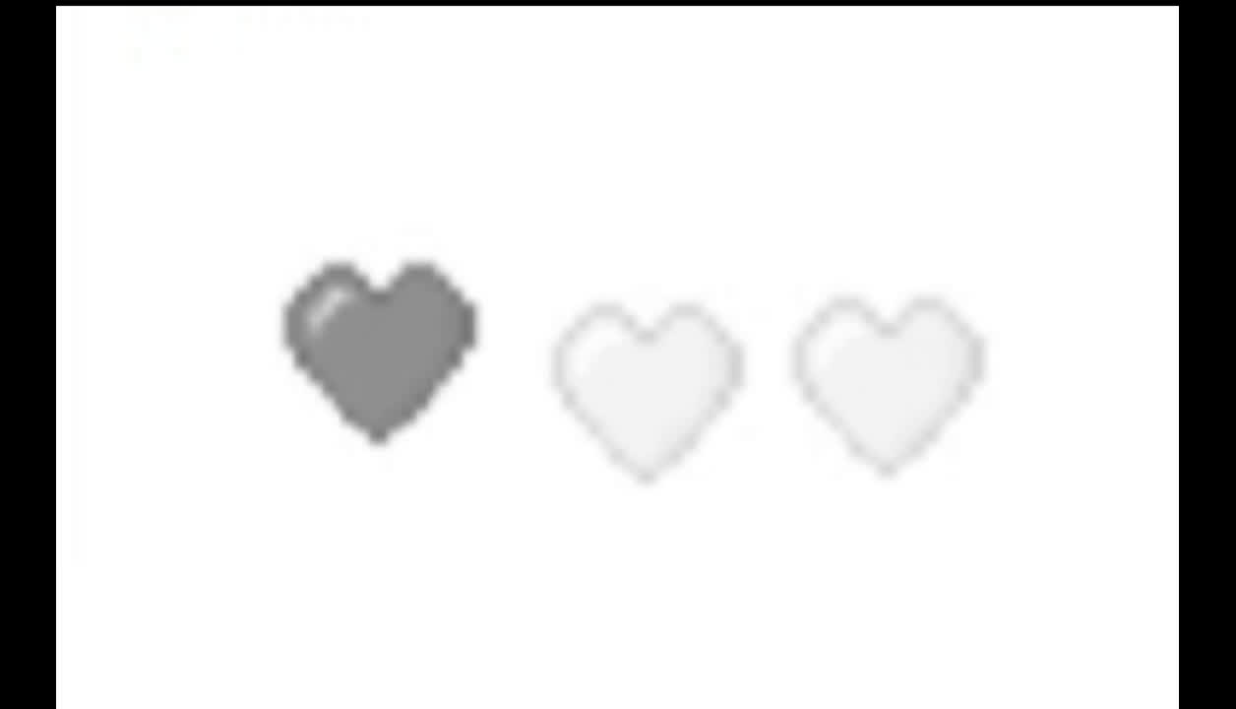
life mechanism
In class Dinasaur:
In main( ):
Life display:

Slide 31


life mechanism
In class Dinasaur:
Death animation:

Slide 32



life mechanism
In main( ):

Slide 33


Demonstration

Slide 34


Conclusion
The inspired chrome dinosaur with the addition of fireball shooting. We learned pygame, assets, collaborate, animate, and more.

Slide 35

Workload
Joshua
Evan
Wilson
Pisco
Fane
Bertrand
Christopher
Chen
Jiawei
Score System
Refining functions
Pause screen
Countdown screen
Code modularity
Errors and bugs
Add initial game
Use GIMP to crop, remove pixels, or grayscale images
Add projectile and tumbleweed
Fix errors and bugs
Add life mechanism
Add sound effect
Control bgm on and off
Add death animation

Slide 36
THANK
YOU

